Slide 1
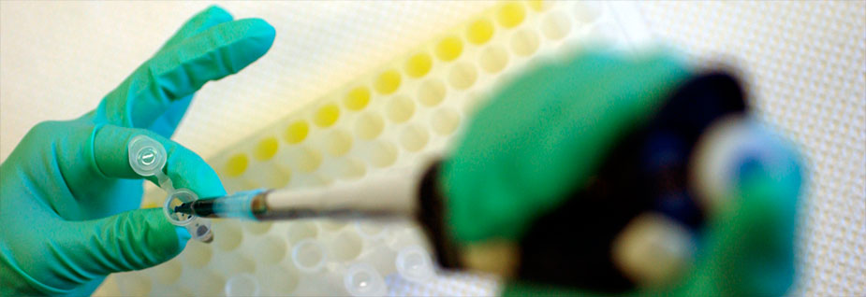
Research Evaluation
In The Age Of Global Digital Scholarship
O’Reilly Strata Conference
Brian Wilson, Vice President, Chief Architect
Healthcare and Science Business
3 February 2011

Slide 2

How can you predict the progress of science?

Slide 3
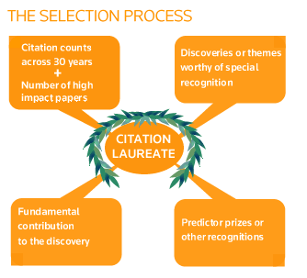
Nobel Prize Predictions
In 1965, Drs. Eugene Garfield and Irving Sher published a paper showing that Nobel Prize winners published five times more papers and were cited 50 time more than the average researcher.
Since 1989, the Science business of Thomson Reuters has correctly predicted at least one Nobel Laureate each year (except for 1993 and 1996).
What does this mean, and
how is it done?
Primary source material is the Web of Science – coverage of 20,000 of the most high impact journals and conference proceedings worldwide
Methodology selects the top 0.1% of papers in each scientific field – narrowing scope to topics and fields of interest
Citation analysis!

Slide 4
WHAT IS CITATION ANALYSIS?

Slide 5
CITATION ANALYSIS
A way to understand connections between the scholarly literature
A way to discover relationships
A way to track and measure productivity and impact

Slide 6

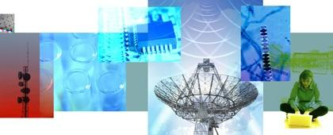
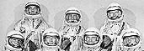
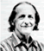

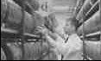
Over 40 years of experience in analysis and metrics
Mesur/ usage
Maps and Research Fronts
Eigenmetrics
PDP-1
ARPANET
CRAY-1
WORLD WIDE WEB
Broader citation sources
H index
1960 1965 1970 1975 1980 1985 1990 1995 2000 2005 2007 2008
Birth of citation analysis
World and University Indicators
Growth of bibliometrics and scientometrics
Web tools
New Metrics
New Sources
Growth of Network analysis and visualisation tools
Notes:
Academic citation analysis was referenced by the founders of Google in their 1998 paper describing PageRank (http://ilpubs.stanford.edu:8090/361/)

Slide 7
THE STRATA OF SCIENCE
THE POST WAR PERIOD

Slide 8
The Post War Period
SCIENCE DRIVERS
Huge influx of government dollars into research and development following World War II
Growing lag time in subject indexing of published findings
Early stages of automation and computerization
Advances in Science and Technology
The Space Age
  Sputnik launched (1957)
  First man on moon (1969)
First nuclear power plant (Obninsk, USSR)
Discovery of spiral structure of DNA
Advances in information processing
First commercial computer (1951)
Silicon transistor invented (1954)
DEC PDP-1 (1960)
Remote terminals via telephone connections
Arpanet (1969)
1950s and 60s
Notes:
Let’s start in the 50s and 60s
What are the science drivers?
What are some of the remarkable achievements?
Silicon transistor invented – 1954 – Gordon Teal, Texas Instruments
First nuclear power plant – Obninsk, USSR
First man on the moon – Apollo 11, July 1969
DNA double helix – Francis Crick and James Watson – collaboration 1951, publication 1953
Other firsts – hydrogen bomb, passenger jets, ultrasound, solar cell
CERN and NASA organized
What about Information processing?
Pior to 1960 – ENIAC – University of Pennsylvania 1946 – 18,000 tubes
First commercial computer – Ferranti Mark 1 – delivered to University of Manchester – 5K operations / sec
PDP-1 Programmed Data Processor 1 – important in creation of “hacker culture” at MIT – 100K operations / sec

Slide 9
Charting the citation metrics evolution
“IMPACT” METRICS
Relate citation count to publication count
Simple, well understood measures
Journal Impact Factor, Immediacy Index
“H” family
Based on rank-ordered publications
Simple metrics rapidly evolving as issues become understood
General metrics applicable to any list of cited publications (journals are one instance).
“influence” METRICS
Based on weightings within entire citation network structure
Eigenfactor, Article Influence. SciMago Journal Rank (SJR)

Slide 10
IMPACT FACTOR
Impact Factor: Average citations from items in 2010 to items published in the journal in 2009 or 2008
Citations in 2010 to years 2009 or 2008
Citable items indexed in 2009 or 2008
Immediacy Index: Average citations from items published in 2005
to items published in 2005
IF 2010 =

Slide 11
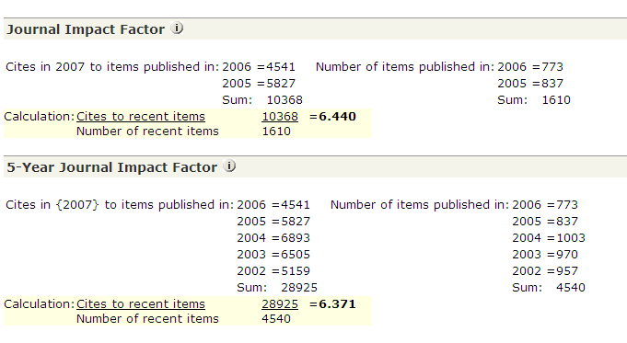
“Impact Factor”: A simple, much-discussed ratio
Definition: Ratio between citations and citable items.
A = total cites in current year
B = current year cites to items
published in two preceding
years (a subset of A)
C = number of articles (‘citable
items’, excluding editorials,
letters, news items, and
meeting abstracts) published
in two preceding years
D = B/C = Journal Impact Factor

Slide 12
“H” Index…
Definition
‘A scientist has index h if h of his or her Np papers have h citations and the other (Np– h) papers have ≤h citations each.’
Combines impact and size
Can be applied to any selection
of articles
Addresses the why not use the median?
Citations
H
Publications Ranked by Citation

Slide 13
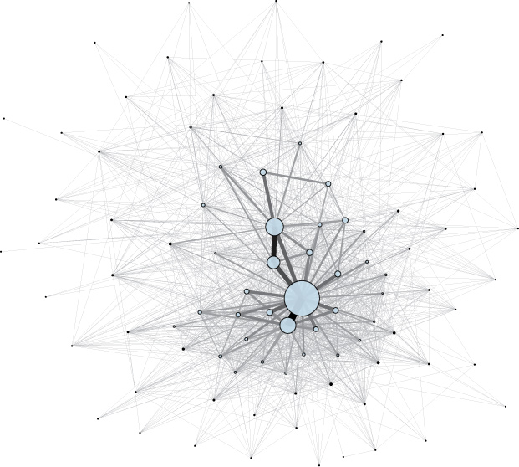
Eigenmetrics ™
EigenFactor Score
Considers the citation network to measure a journal’s citation influence
Derived from JCR cited journal data (5 years)
Article Influence Score
Analogous to Impact Factor
Measures ratio of journals’ citation influence (EF score) to the size of the article in
that period

Slide 14
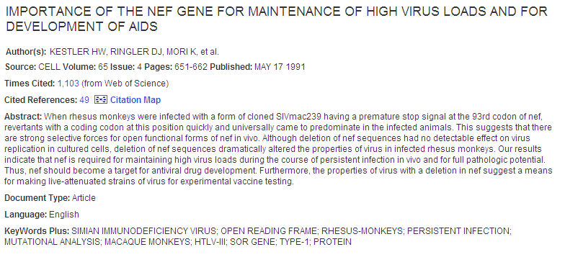
Citation Index –
A Valuable Search Tool
The language of research is constantly changing, as research progress concepts and terminology evolve.
Text based searching may miss critical information
Network linkages through citations facilitate the discovery of information across the boundaries of terminology
LAV
(Europe)
HTLV-III
(USA)
HIV + many variants, “SIV”
???
1983
1987
Present
Future
This particular article is highly cited and relevant, but does not contain the term “HIV”
Therefore, this record cannot be found by searching for the text “HIV” but is easily found by using citations

Slide 15
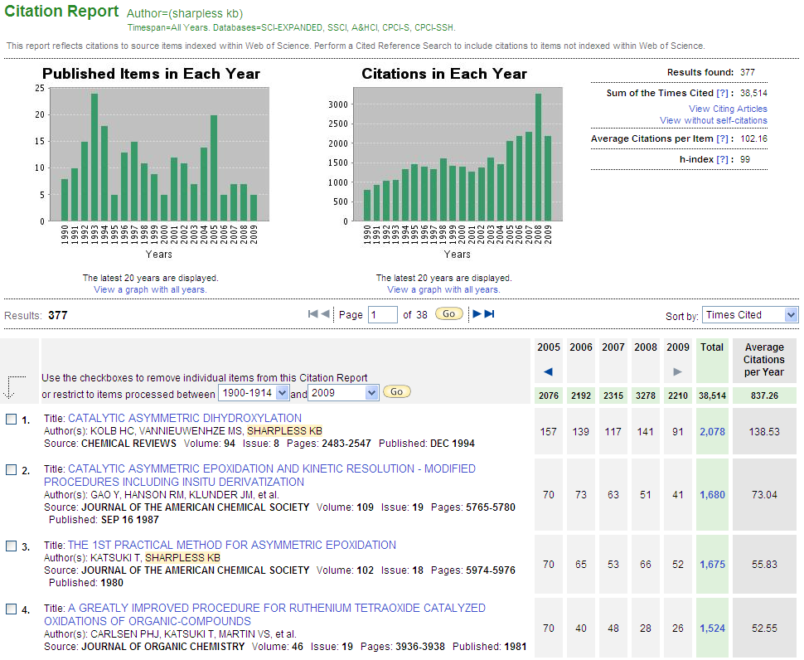
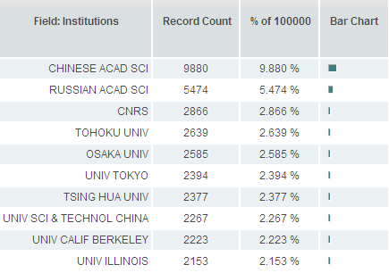
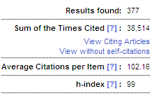
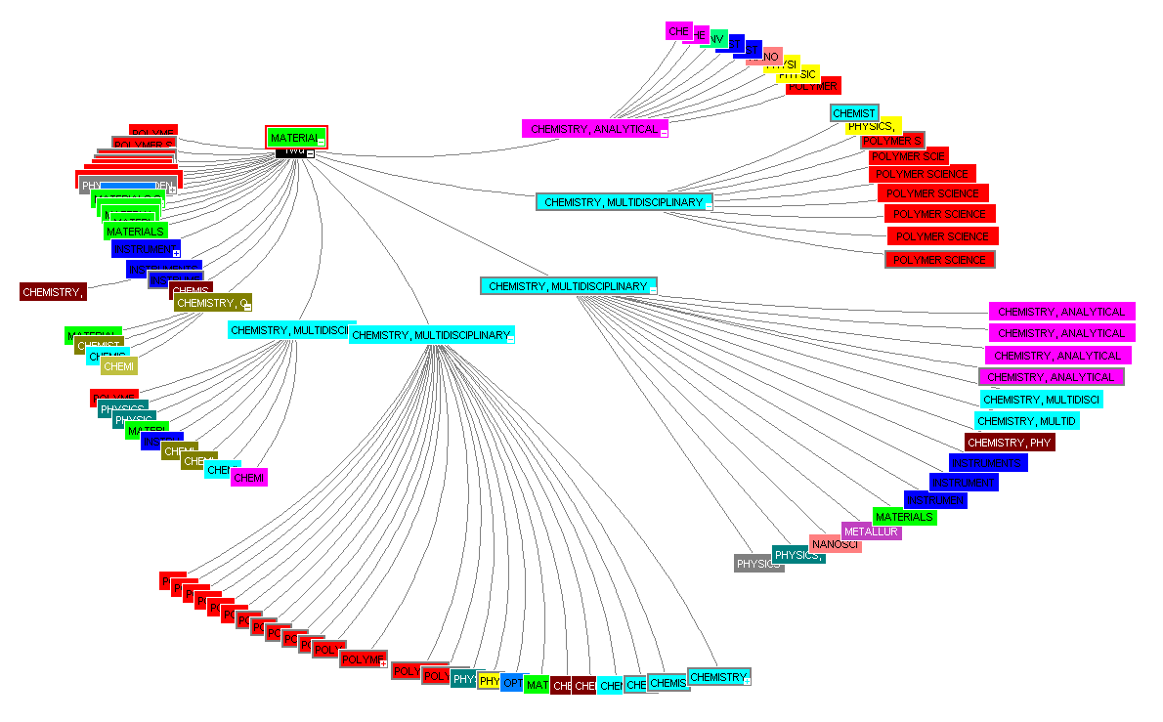
Web of Science – Discovery Tools
Analyze results for detailed analysis such as collaborator identification
Instant Citation Reports
to easily evaluate research
and identify trends
Visualize citations using the Citation Map. Identify trends and track research pathways

Slide 16
THE STRATA OF SCIENCE
The Oil Crisis and
Space Exploration

Slide 17
The Oil Crisis and
Space Exploration
SCIENCE DRIVERS
Truly large scale scientific projects
Growth of European cooperation
Growing resource scarcity & funding optimization
Rise of environmentalism and energy scarcity
Advances in Science and Technology
Skylab, Salyut, and the Space Shuttle
Robotic inter-planetary discovery
  Voyager program (1977+)
  Mars Vikings (1975)
Consumer technology and personal computers
VLSI integrated circuitry fabrication
Advances in information processing
PCs, GUIs, and mice
C programming language
Solid state memory
First supercomputer
Commercial fiber optics
1970s and 80s
1950s and 60s
Notes:
The 1970s and 80s are a story of growth and increasing cooperation driven by real resource contention
“Big Science” truly came of age – big budgets, big staffs, big machines, big laboratories
Term popularized by Alvin Weinberg, head of Oak Ridge National Laboratories in 1961
The Space Age was in full swing
European Space Agency established 1975
Skylab 1973, Salyut 6 1977, Salyut 7 1982, Mir 1986
And yet, at the same time, there was a real acknowledgement that resources were limited and needed to be shared – energy, the environment
OPEC announces oil embargo against US in 1973
Car-free days in many European countries
Environmentalism
First Earth Day – April 22, 1970, Endangered Species Act 1973, Three Mile Island 1979
Globally – Bhopal disaster 1984, Chernobyl 1986, Exxon Valdez 1989
You’ll note that my section on advances in technology begin to blend with advances in information processing - because of the increasing importance of information technology to science
Apple 1 1976, IBM PC launched 1981, Apple Mac 1984
Don’t intend to start any religious wars – one of, if not the first laptop, The Epson HX-20 was released in 1983
Cray-1 supercomputer – Seymour Cray 1976

Slide 18
What are some data challenges with evaluating “big science?”
Subject focuses
Quality differentiators in journal selection
Different citation characteristics
Ensuring Quality
The print to electronic evolution dilemma
An appropriate balance of human curation and automation
Disambiguation
Authors
Institutions
Subjects
News sources
of content
Open datasets
Blogs
Videos

Slide 19
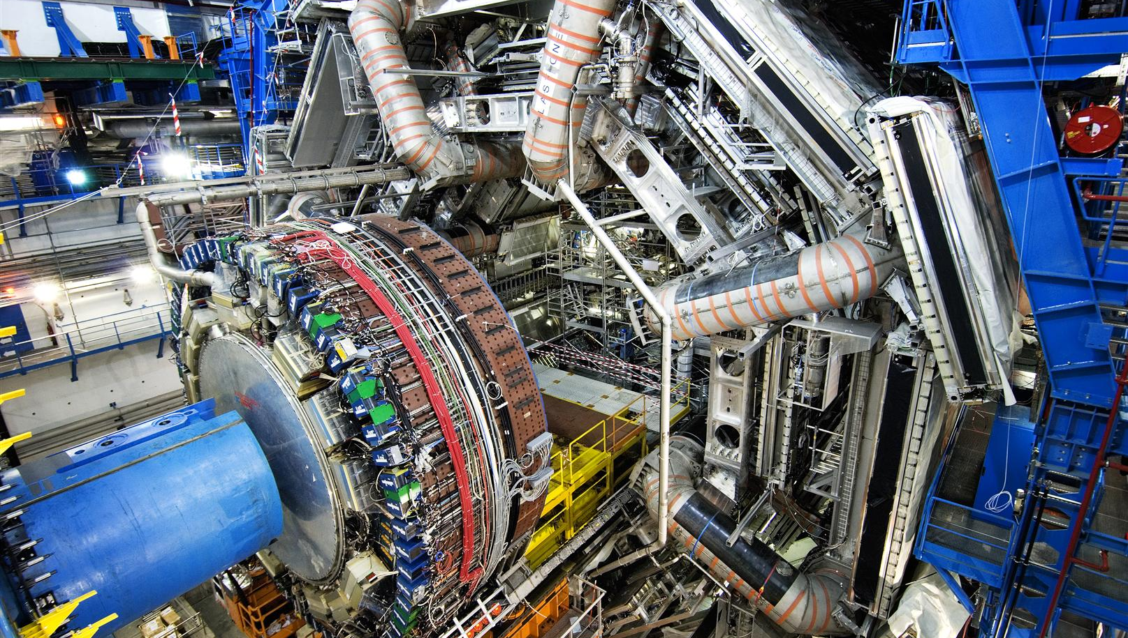
An Example: CERN
Collaboration in High Energy Physics
“CERN - where scientists smash stuff at the speed of light to produce new stuff... get pretty
excited about that... and eventually write articles.”
- Dr. Salvatore Mele, CERN Head of Open Access
© COPYRIGHT CERN Photograph: Claudia Marcelloni, 16 Feb 2007

Slide 20
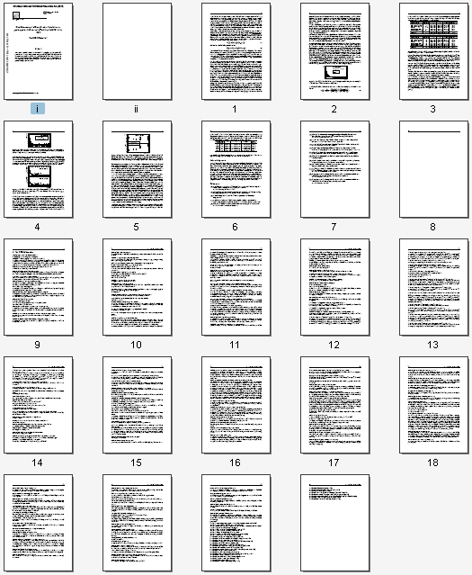
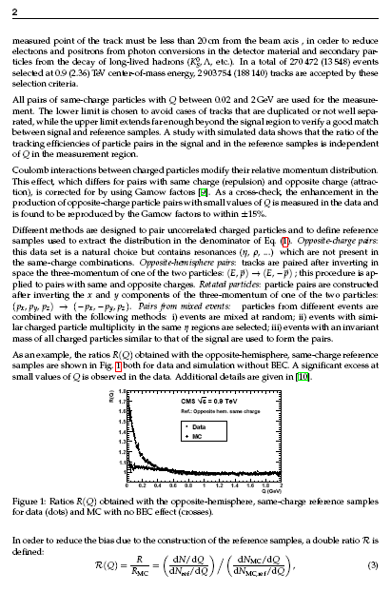
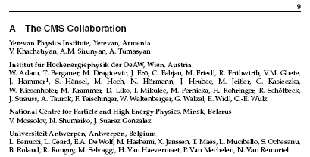
Author Disambiguation and Shared Research
7 Pages of Research
14 Pages of Authors
and Acknowledgements
Source: ArXiv.org http://arxiv.org/abs/1005.3294v1

Slide 21
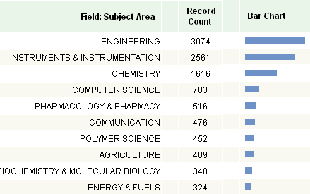
What’s in a name?
215, 635 occurrences of surname Li
36,828 occurrences of surname Li, first initial X
6,171 occurrences in Web of Science (2008)

Slide 22
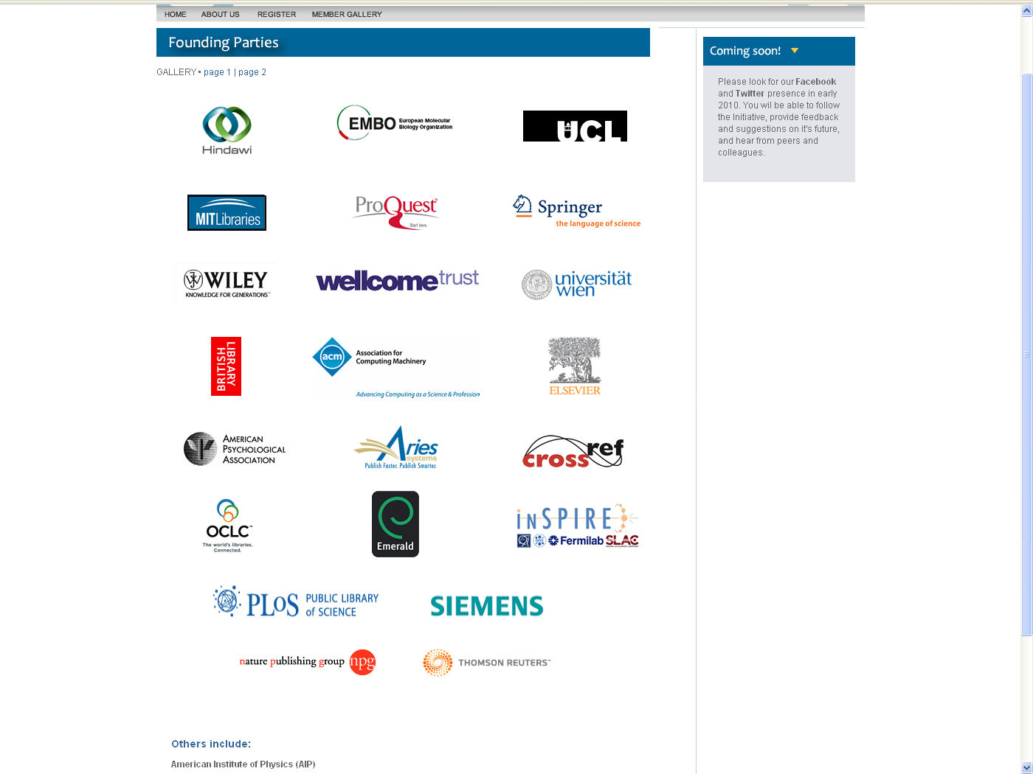

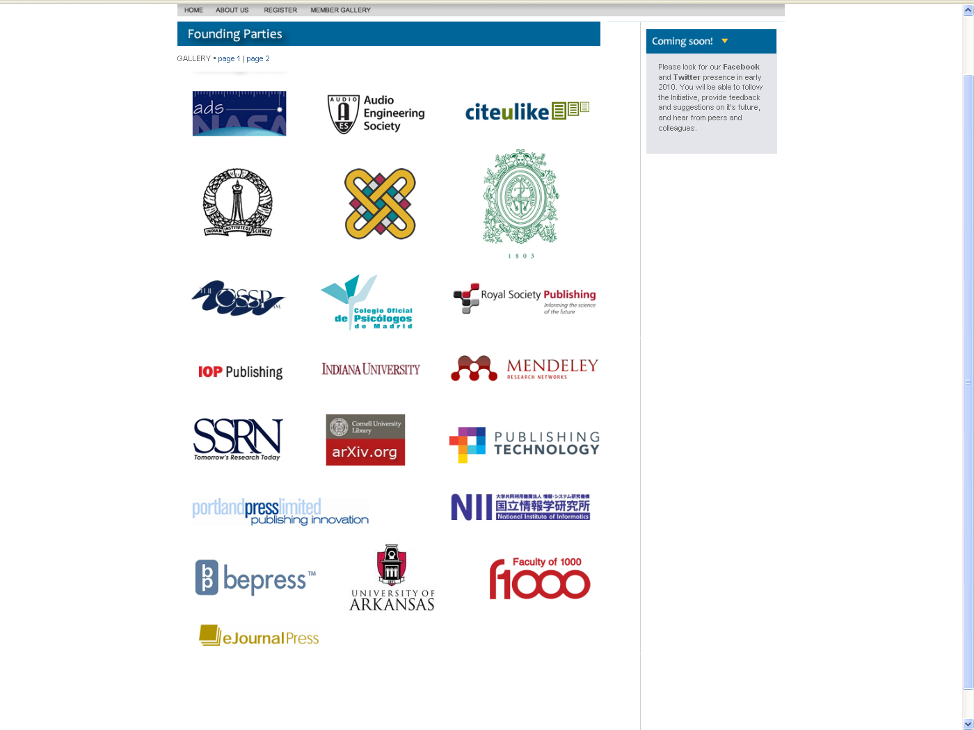




Working to resolve global name ambiguity
Notes:
ORCID, Inc. aims to solve the author/contributor name ambiguity problem in scholarly communications by creating a central registry of unique identifiers for individual researchers and an open and transparent linking mechanism between ORCID and other current author ID schemes.

Slide 23
THE STRATA OF SCIENCE
Globalization and
the Beginning of the Information Age

Slide 24
Globalization and the Beginning of the Information Age
SCIENCE DRIVERS
Removal of international barriers
Large scale international collaboration
Funding organization encouragement of collaboration
Opportunities to use and share data via the world wide web
Advances in Science and Technology
Human Genome Project
Widespread adoption of cell phones
Hubble Space Telescope (1990)
International Space Station (1996)
Civilian Global Positioning System (1996)
Advances in information processing
The World Wide Web (1989+)
PGP encryption (1991)
Intel Pentium processor (1993)
Linux kernel developed (1992-94)
1990s
1970s and 80s
1950s and 60s
Notes:
This time, let’s consider the 1990s – this period is characterized by removals of political barriers to collaboration and technology advances that bring true, immediate global connectivity
1989 disintegration of the Warsaw Pact and dissolution of Soviet Union in 1991
European Union – Maastricht Treaty completed November 1, 1993
As an example, the NSF Catalyzing New International Collaborations solicitation (http://www.nsf.gov/funding/pgm_summ.jsp?pims_id=12815)
Human Genome Project – started by US Department of Energy’s Office of Science in 1990
A rough draft was announced completed in June 2000 by Bill Clinton and Tony Blair
Goal – identify and map 20,000-25,000 genes in the human genome
The World Wide Web
PGP encryption (public key encryption program) released in 1991 by Phil Zimmermann

Slide 25
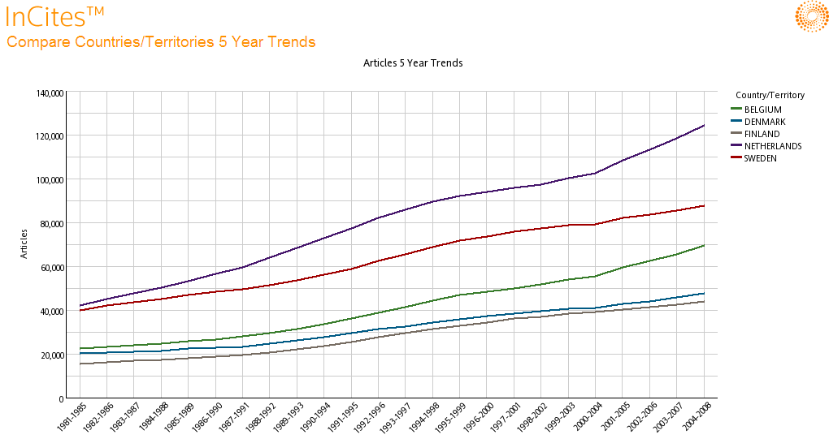
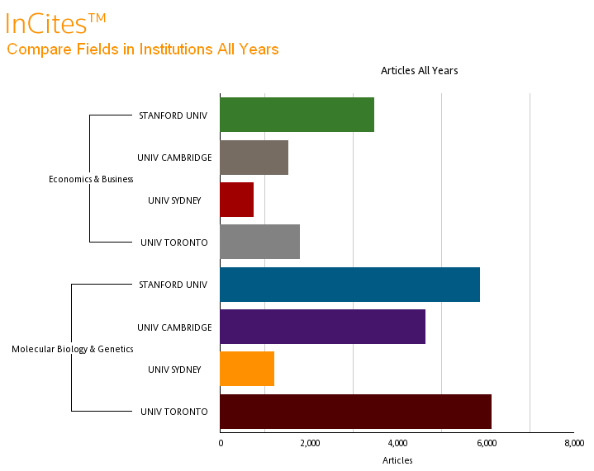
Global Comparisons
Netherlands:
35% increase over 10 years

Slide 26
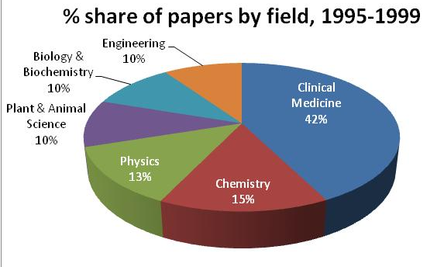
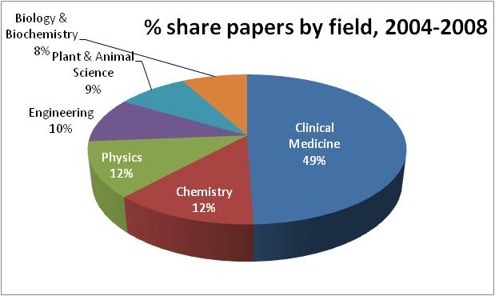
Analyze countries: Netherlands top 6 fields
-2% Biology & Biochemistry

Slide 27
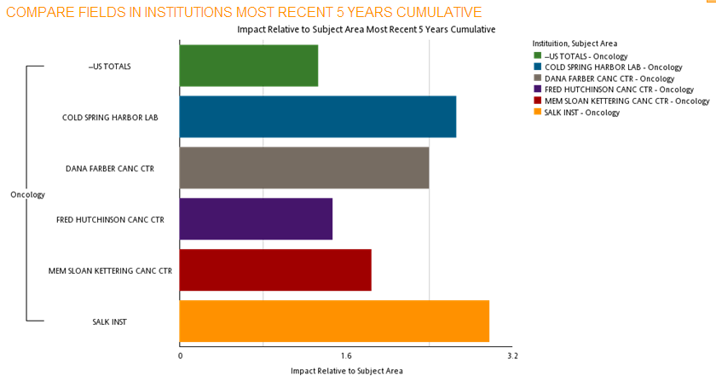
How do I benchmark, rank, and analyze my institution?
+33%
+166%
+140%
+47%
All of these institutions exceed the field average, as well as the US average.
+84%
+197%

Slide 28
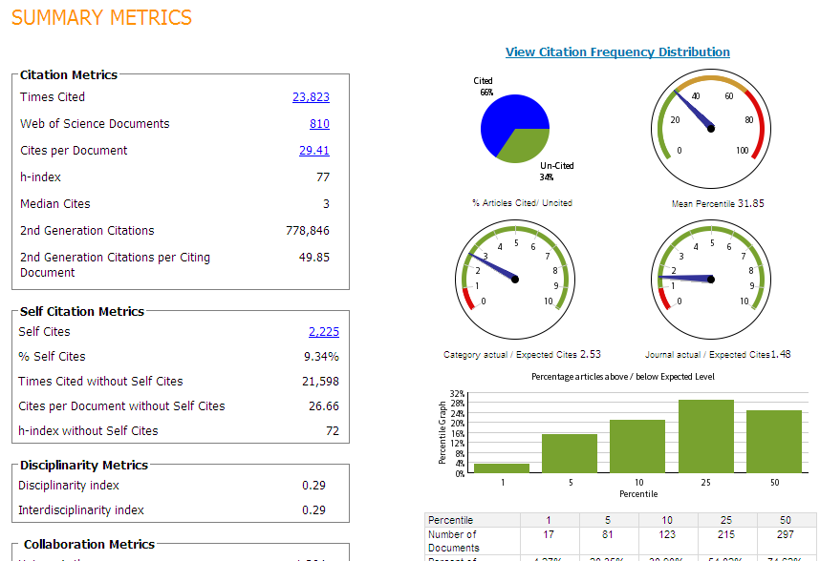
Dr. Fuster’s overall performance
H index:
77 papers have been cited at least 77 times each
Mean percentile
average, Fuster’s papers rank in the top 31% of their respective fields
Journal actual/expected ratio
Fuster gets cited 48% above average for the journals he publishes in
Self citation analysis
9.34% of Fuster’s citations are self citations. H index without self citations is 72.

Slide 29
CITATION METRICS
What do we evaluate?
Region: Country, Territory | Reputation Rankings Stars Success Stories
Organization Level: University, Institute, Corporation, Funder
Person Level: Researcher, Team, Research Project
Item level: grant, paper, patent, award, activity
Citation metrics are one piece of the research performance puzzle.
They complement other types of assessment.
Citation Metrics
Funding data
Awards/Honors
What do we report?
Counts of, outputs, activities, funds, and items | KPIs Efficiency Productivity Operational Financial
Citation metrics
Time trends and changes
Relationships by citation or co authorship
Relative measures and Benchmarks
Peer Review
Peer review

Slide 30
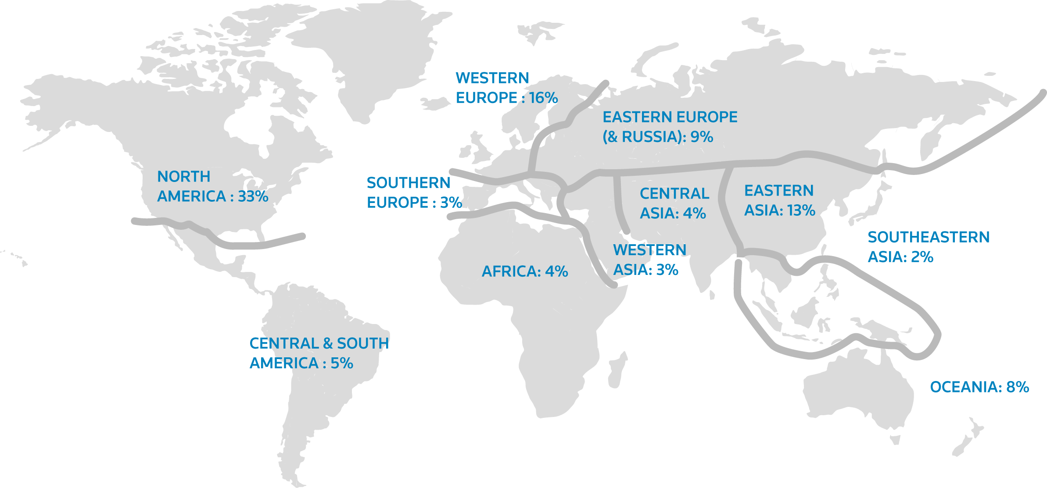
Global Institutional Profiles Project
Academic Reputation Survey
Asked academics around the world to give feedback on the reputation of academic institutions, with a clear distinction between the reputation for Research and Teaching
First run of the survey completed in May 2010
Mixed function of respondents
  Academic Staff 69%
  Research staff 15%
  Institutional 7%
  leadership
  Graduate/post 6%
  grad students

Slide 31
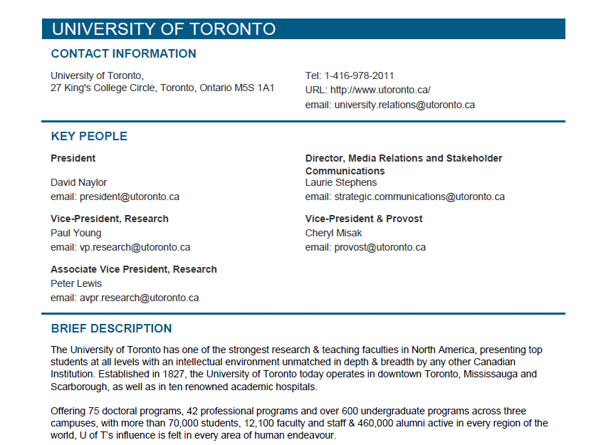
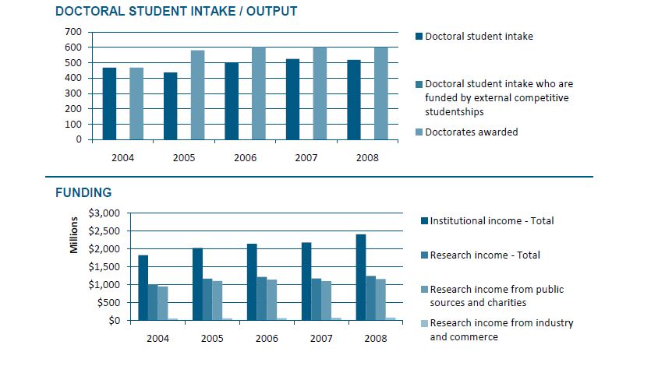
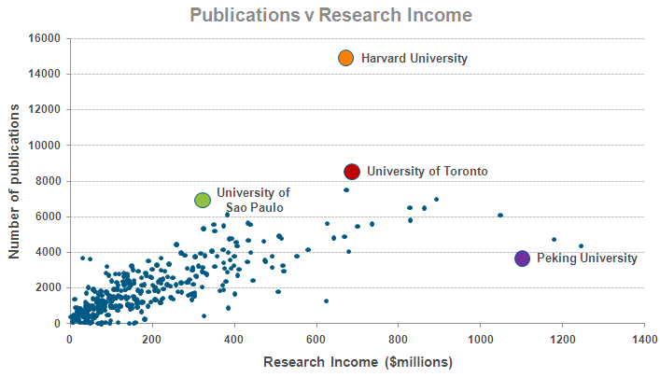
Example Institutional
Profile and Trends

Slide 32
THE STRATA OF SCIENCE
THE BUSINESS OF SCIENCE

Slide 33
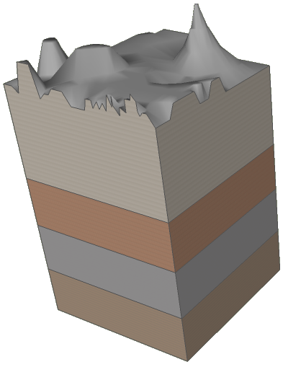
The Business of Science
SCIENCE DRIVERS
Increased collaboration between academia, government and industry
Academic research facilities seeking business oriented efficiencies
Increasing growth in Asia
Advances in Science and Technology
First commercial Flash drives – 2000
Wikipedia - 2001
First self-contained artificial heart - 2001
Mars Exploration Rovers - 2004
Autonomous automobiles - 2005
Advances in information processing
Pervasive search technologies
Semantic technologies
Web 2.0
Broadband proliferation
“The Cloud”
2000 and
Beyond
1990s
1970s and 80s
1950s and 60s
Notes:
In the 2000s we see increasing collaboration between academia and industry – particularly in the Life Sciences
We see continuing growth in Asia - TR reported in October that China’s patent filings grew by 26.1% annually between 2003 and 2010 – and will likely become top patent producer in 2011. China set up their patent system in 1985.
What are some other advances we’ve seen?
Google – began selling advertising in 2000 – IPO in 2004
Semantic – folksonomies, advanced natural language processing, automated translation
Web 2.0 – at another O’Reilly conference – 2004

Slide 34




COMMON DRIVERS ACROSS SCIENCE
Funding Pressures
Efforts at Objective Approaches to Promotion and Tenure
Reputation Management & Demonstration of Achievement
Global Competition in the Sciences – BIG SCIENCE
Changing Nature of Scholarly Journal Publishing
Notes:
Need to fund new types of research cross cutting science, translational medicine, collaborative endeavors; old qualitative approaches are no longer viable
Universities’ need metrics to support strateic direction decisions and understand the impact of their research programs that get beyond the simplicity and skewed nature of national rankings
Being found, getting attribution, and finding colleagues in a global research environment is imperative for collaborating with the local and global research community
library is extending its role in new ways as the institution implements ongoing assessment and impact exercises

Slide 35

Regional characteristics drive appetites for Evaluation
The scientific discovery process is universally accepted and practiced in a similar fashion world wide. Science evaluation process varies by region and largely driven by the research funding structures by country and general attitudes toward to metrics and comparisons.
Metrics
Evaluation Systems
35

Slide 36
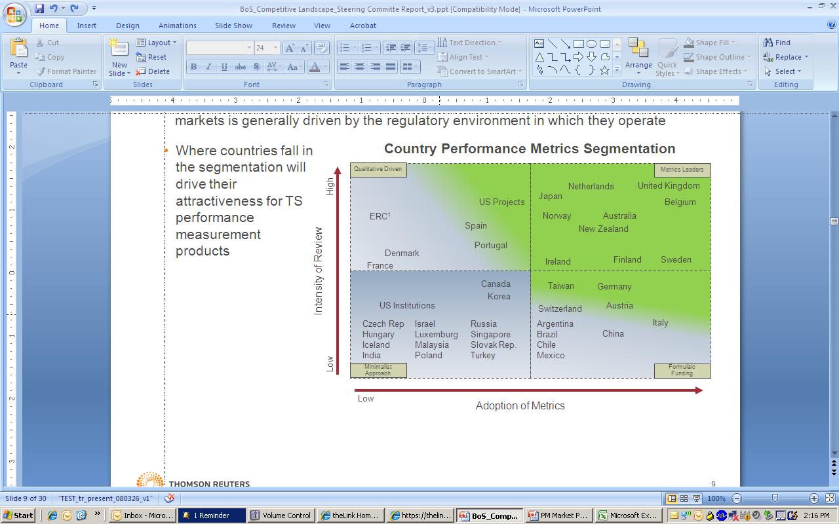
Performance Evaluation
Global Demand
Market Driver: Relative use of performance metrics within the academic markets are generally driven by the regulatory environment in which they operate
36

Slide 37
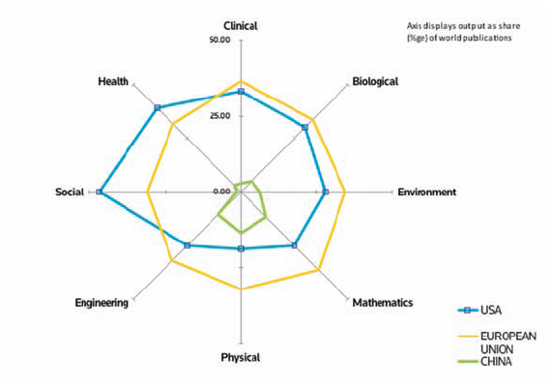
Different locales, different focuses
SOURCE: Thomson Reuters Web of Science(SM)

Slide 38
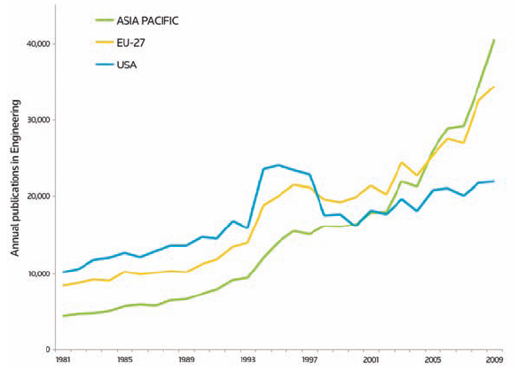
Annual publication output in Engineering
SOURCE: Thomson Reuters Web of Science(SM)

Slide 39
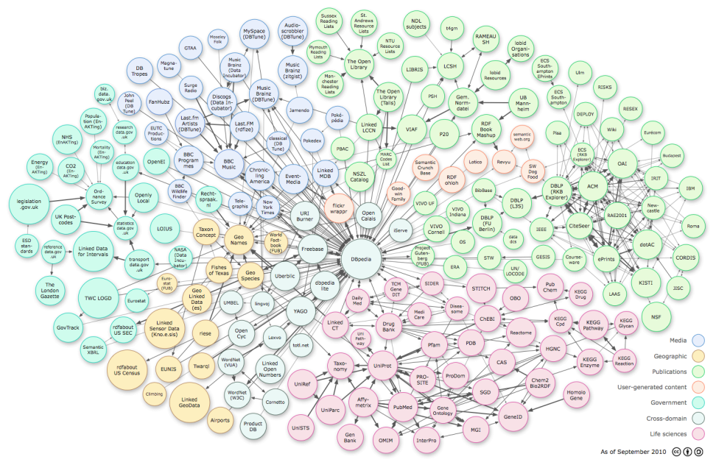
Data is growing
Science has grown faster than our ability to keep up
Estimated 20,000 papers published daily
Laboratory Information Management Systems (LIMS) market size will grow from US $395M in 2008 to US $454M in 2013.
Data is growing – a recent IDC study indicated that the Digital Universe grew to 1.2 ZB and by 2020 should be to 35 ZB
The Open Data community is constantly launching new repositories – the number of data sets is doubling every year
Selectivity is a must:
Which articles should a researcher read?
Which journals should a library subscribe to?
Which projects and researchers should be funded?
Data based decision making
increasingly important
“Linking Open Data cloud diagram, by Richard Cyganiak and
Anja Jentzsch. http://lod-cloud.net/”
Notes:
Data is growing
A zettabyte is million gigabytes – picture a stack of DVDs reaching from the earth to the moon and back (http://www.emc.com/collateral/demos/microsites/idc-digital-universe/iview.htm)
LIMS market estimate from ARC Advisory Group (http://www.controlglobal.com/industrynews/2009/042.html)
Becoming more integrated with a wider variety of laboratory equipment and electronic lab notebooks
“Linking Open Data cloud diagram, by Richard Cyganiak and Anja Jentzsch. http://lod-cloud.net/”

Slide 40
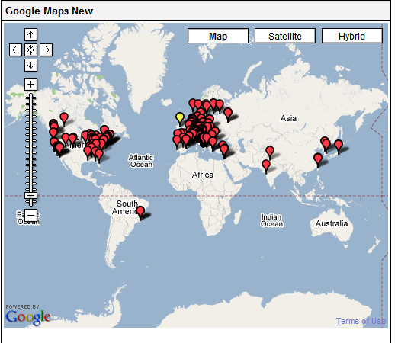
Digital scholarship is collaborative and global

Slide 41
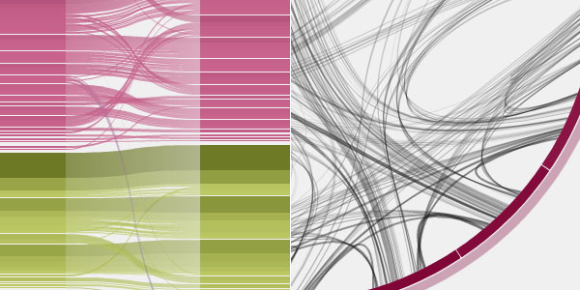
Bandwidth is connecting us and letting us…
…view, understand, and interact with what is happening now
Image retrieved from infosthetics.com/archives/2009/01/eigenfactor...
Notes:
From Moritz Stefaner, Eigenfactor.org
First is a Sankey Diagram which shows changes over time
Second shows a citation network in a circular graph – line size is connnection strength

Slide 42
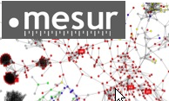
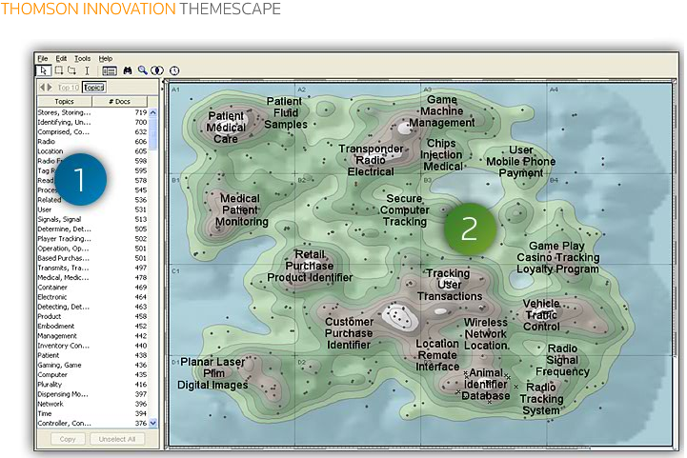
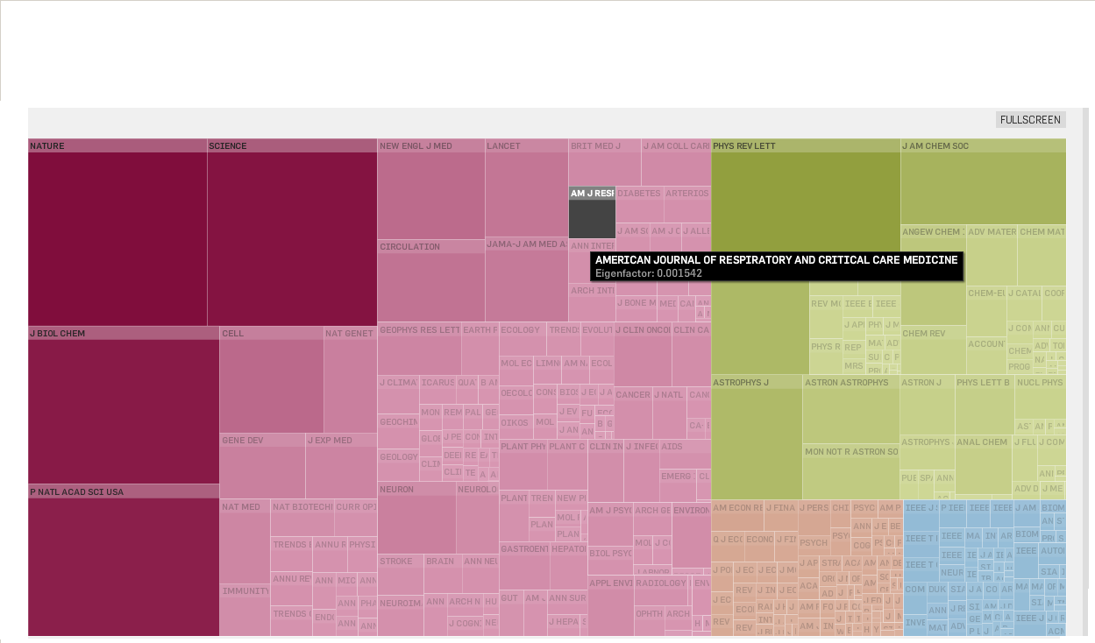
Big Data is changing our understanding
Expectations are changing...
Real time
In context
Open & widely available
mesur
Mapping usage downloads and citation
Tools are
changing...
THOMSON INNOVATION THEMESCAPE
Analyzing large search results sets using term overlap and multidimensional scaling
Data accessibility
Large computations on large datasets
Visualizations
Neural Network
Display of Eigenfactors for corpus of JCR journals
Notes:
MESUR (www.mesur.org) – The project's major objective is enriching the toolkit used for the assessment of the impact of scholarly communication items, and hence of scholars, with metrics that derive from usage data.
Johan Bollen is the Principal Investigator, Herbert Van de Sompel serves as an architectural consultant, and Aric Hagberg of the LANL Mathematical Modeling and Analysis group serves as modeling consultants.

Slide 43
QUESTIONS

